Slide 1

Loan Data Analysis ETL Pipeline
George Ge

Slide 2

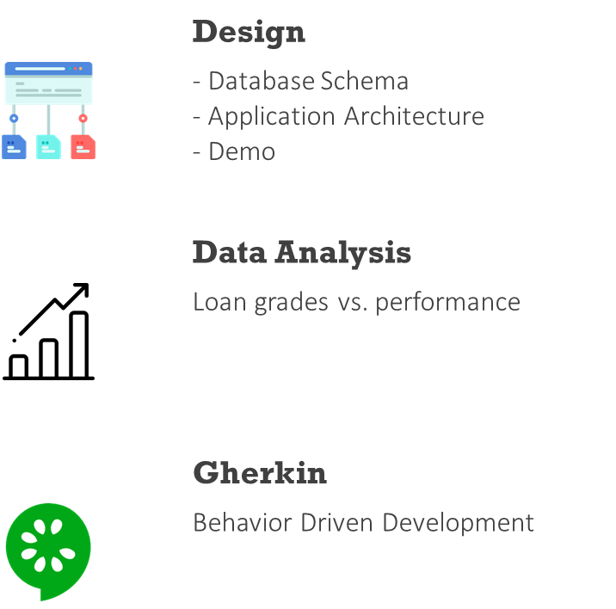
Agenda
Main points
Notes:
Start with an explanation of how I designed my ETL pipeline
Then do a lite demo showcasing my ETL
Didn’t have much time to do Data Analysis, but I did investigate…
Adventures with Gherkin: BDD occupied a very large part of my time.

Slide 3

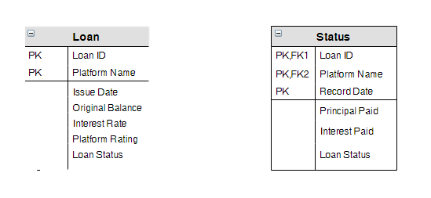
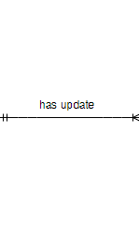

Database Schema
Notes:
Problem – design an ETL pipeline that will provide a common format/clean data
Provided some important attributes of loans
Here’s the format

Slide 4
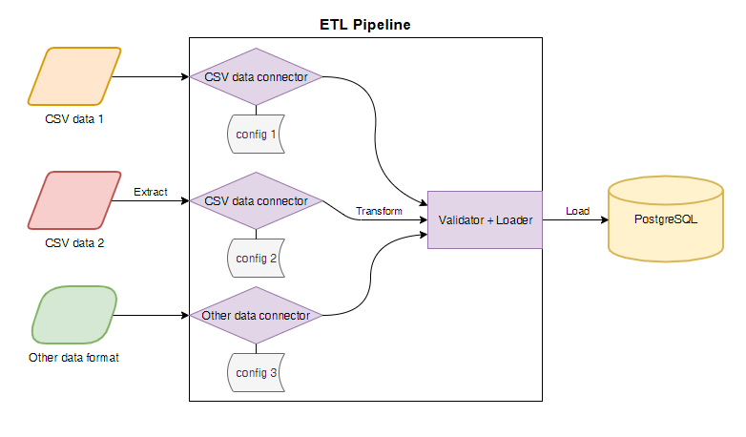
Application Architecture
Notes:
I wanted my ETL to be very modular
Connectors, dbs, db schemas
Ended up with ETL framework
Show you why

Slide 5
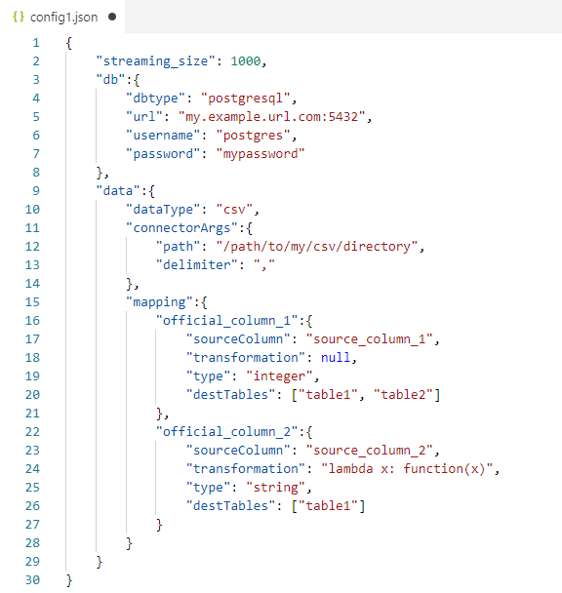
Configuration

Slide 6

Demo
We will run the ETL pipeline on a subset of the data in this demo.

Slide 7
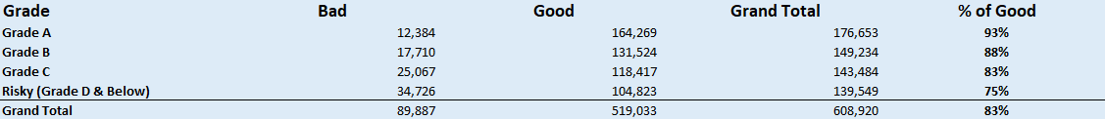
Data Analysis
How does the loan grade inform the performance of the loan?
12%
7%
93%
88%
Notes:
Interested - how the loan grade in general predicted performance
No fancy jupyter notebooks, excel
Subset of data
Consolidated all the grades A+ and D-
Consolidated all the “good” and “bad” statuses

Slide 8
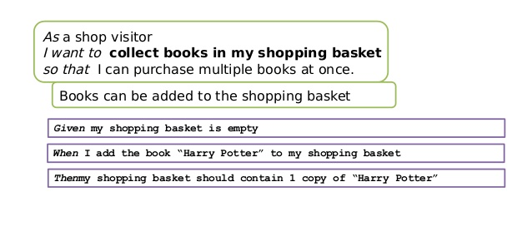
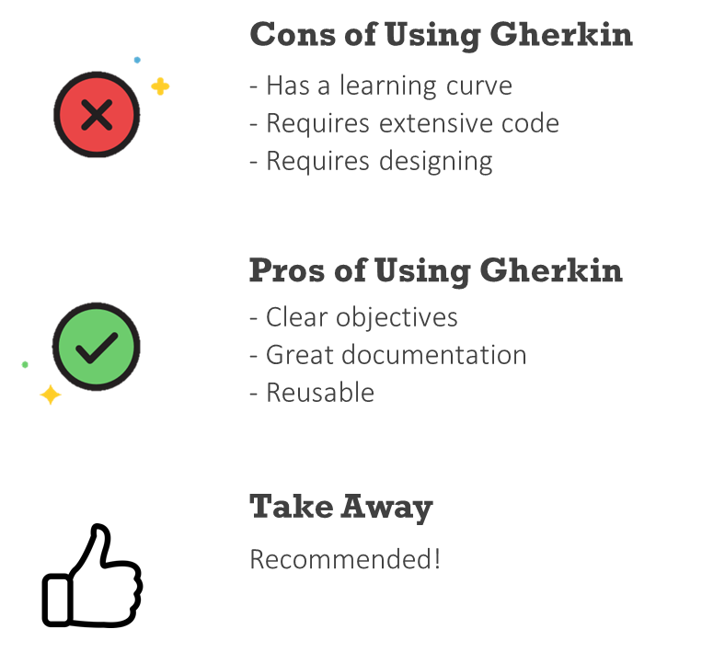
Behavior Driven Development ( Gherkin )

Slide 9





Thank You
George Ge
+1 908 601 3913
george.jiaqi.ge@gmail.com
https://www.linkedin.com/in/george-ge-1048073a
Notes:
Thank everyone for amazing experience
A lot of firsts:
Design ETL
TDD
Officially worked on a personal project
Helpful: answered all my pressing questions about the data
Questions?

